Slide 1

MINI PROJECT ON HR ANALYTICS
SUBMITTED TO :- ABHISHEK TIWARI Submitted by :-
Shreyash Gaur (201500674)
Devesh Srivastav (201500217)
Shivanshu Agrawal (201500666)
Siddhant Yadav (201500689)
Prakhar Verma (201500495)

Slide 2
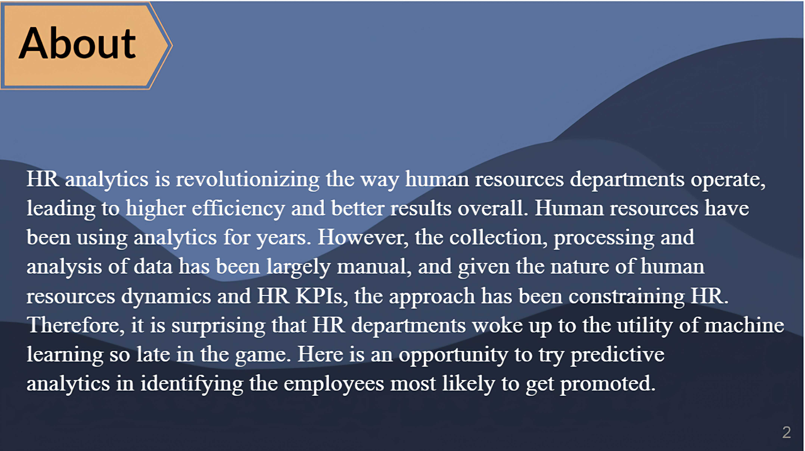

Slide 3
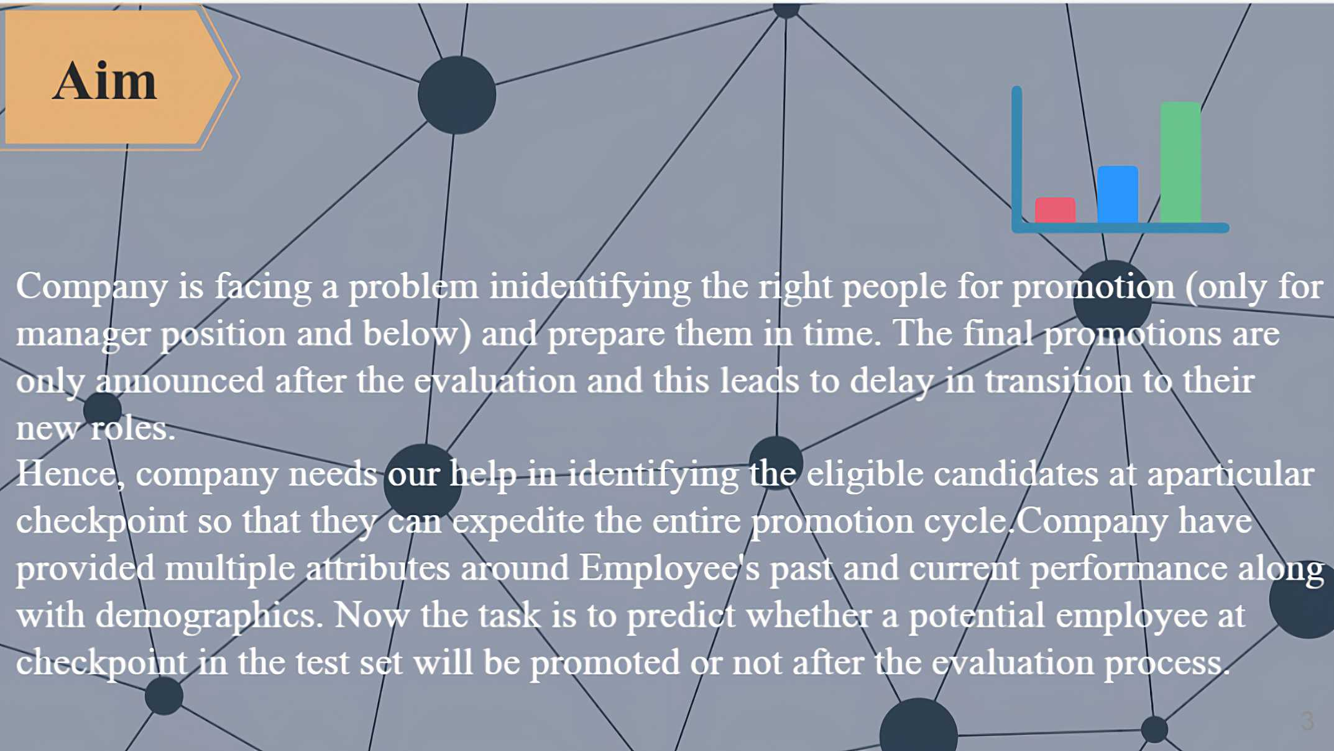

Slide 4
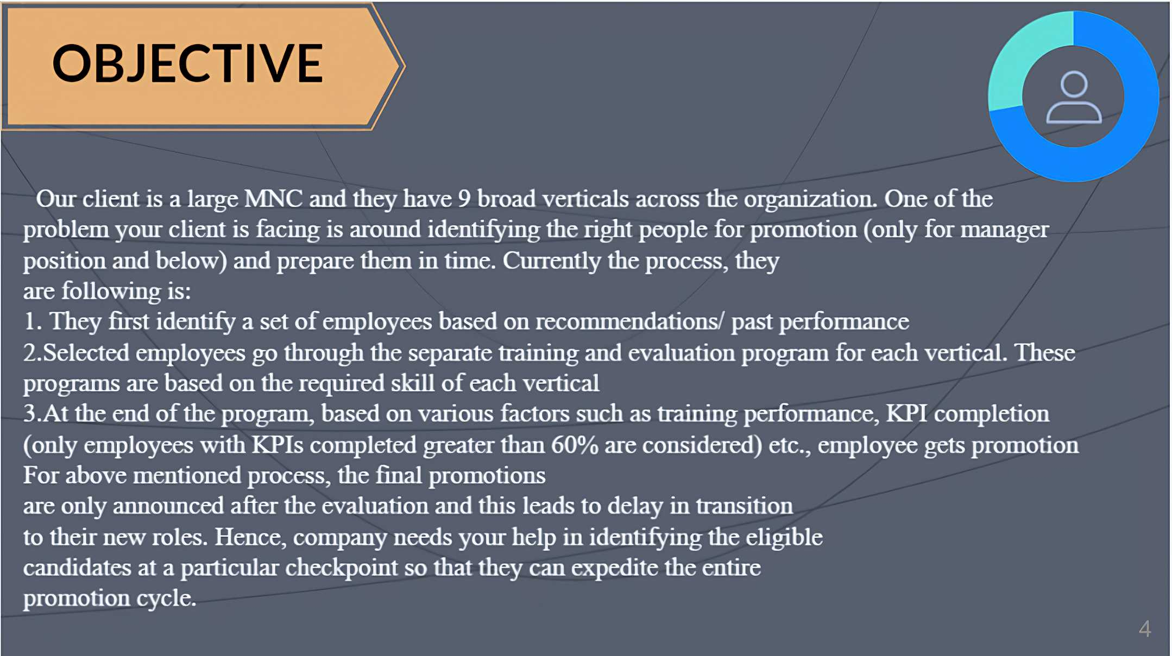

Slide 5
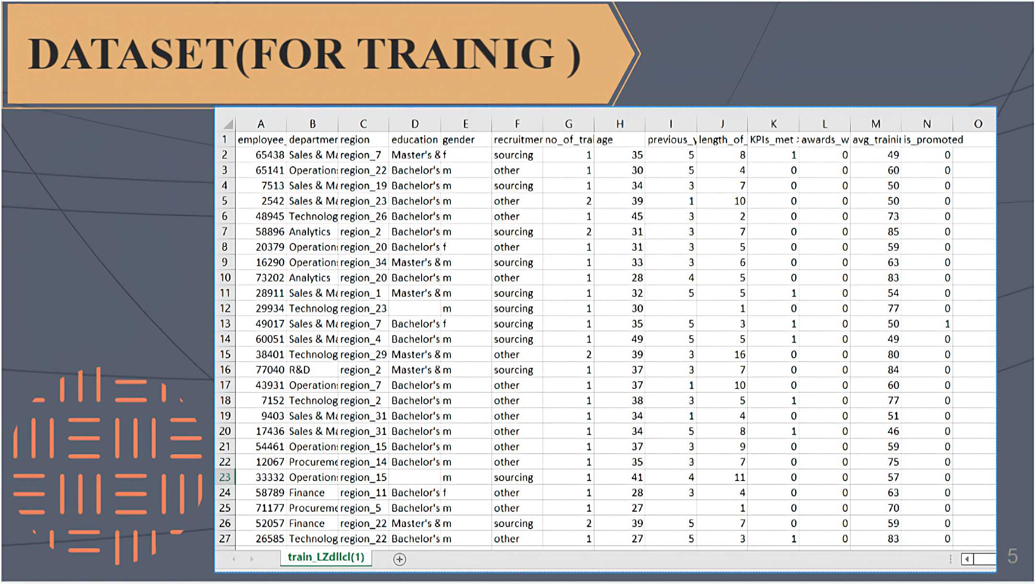

Slide 6
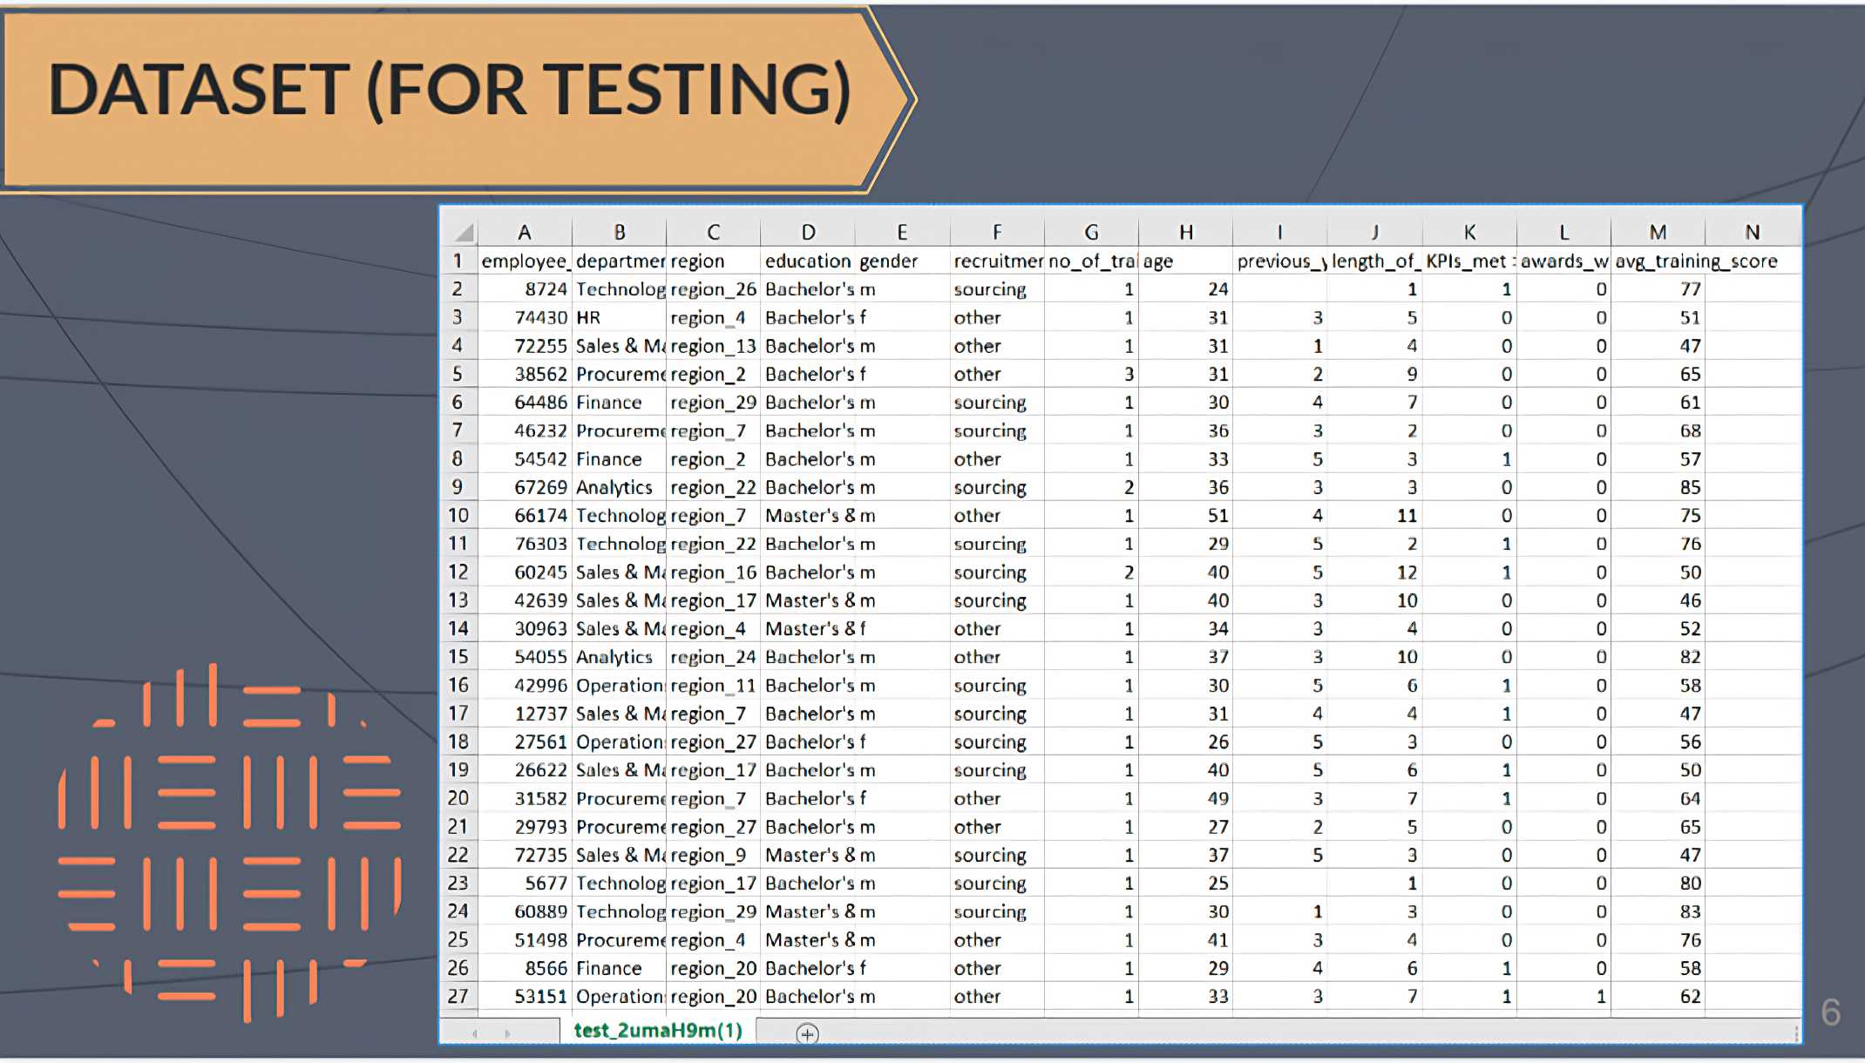

Slide 7
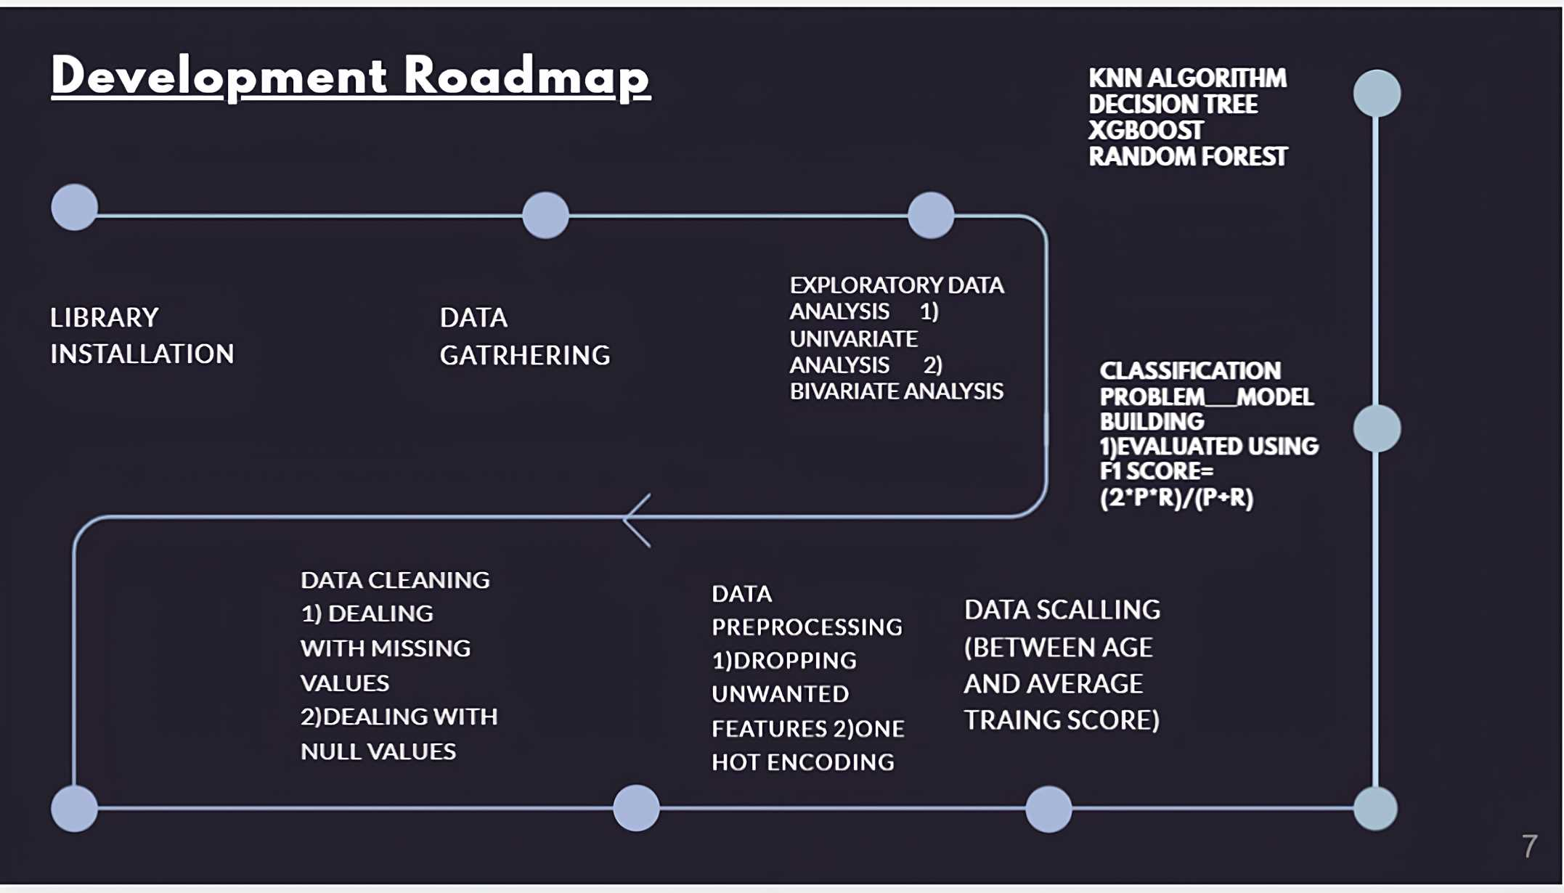

Slide 8
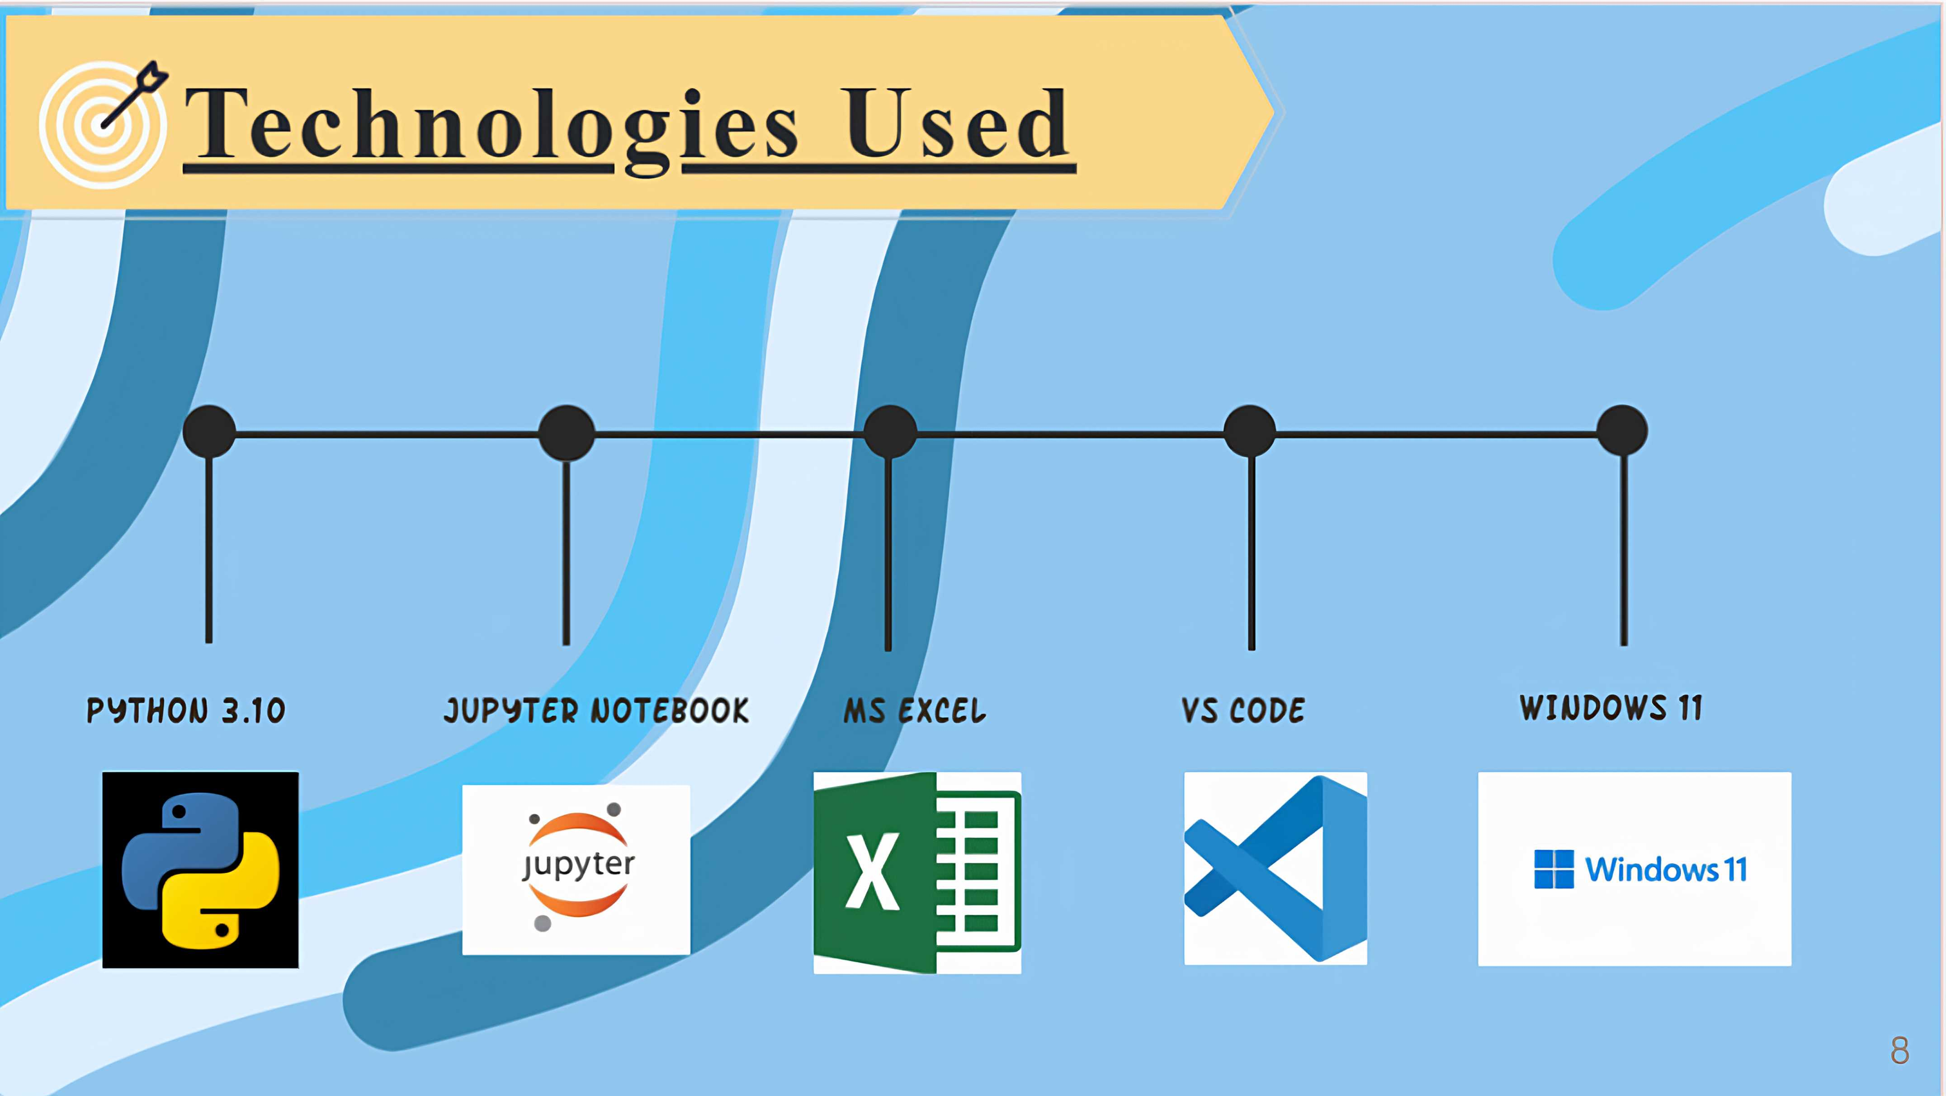

Slide 9
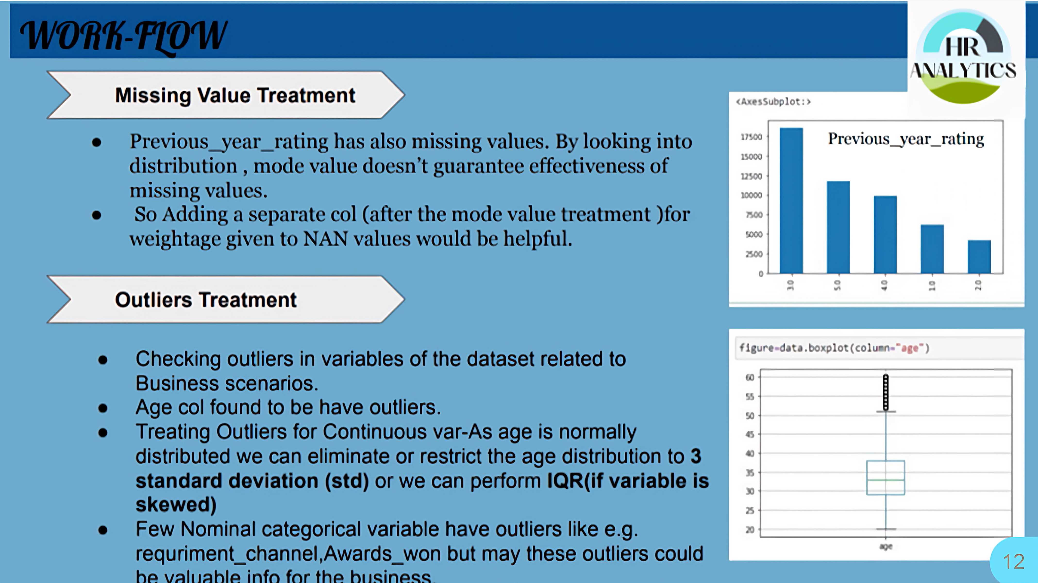
9

Slide 10

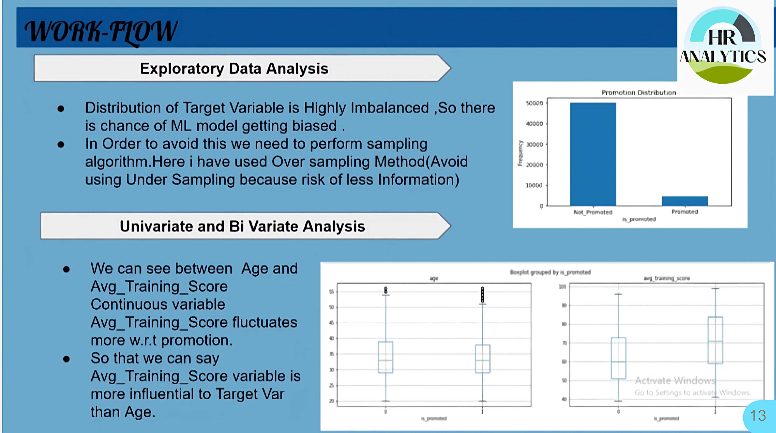
10

Slide 11
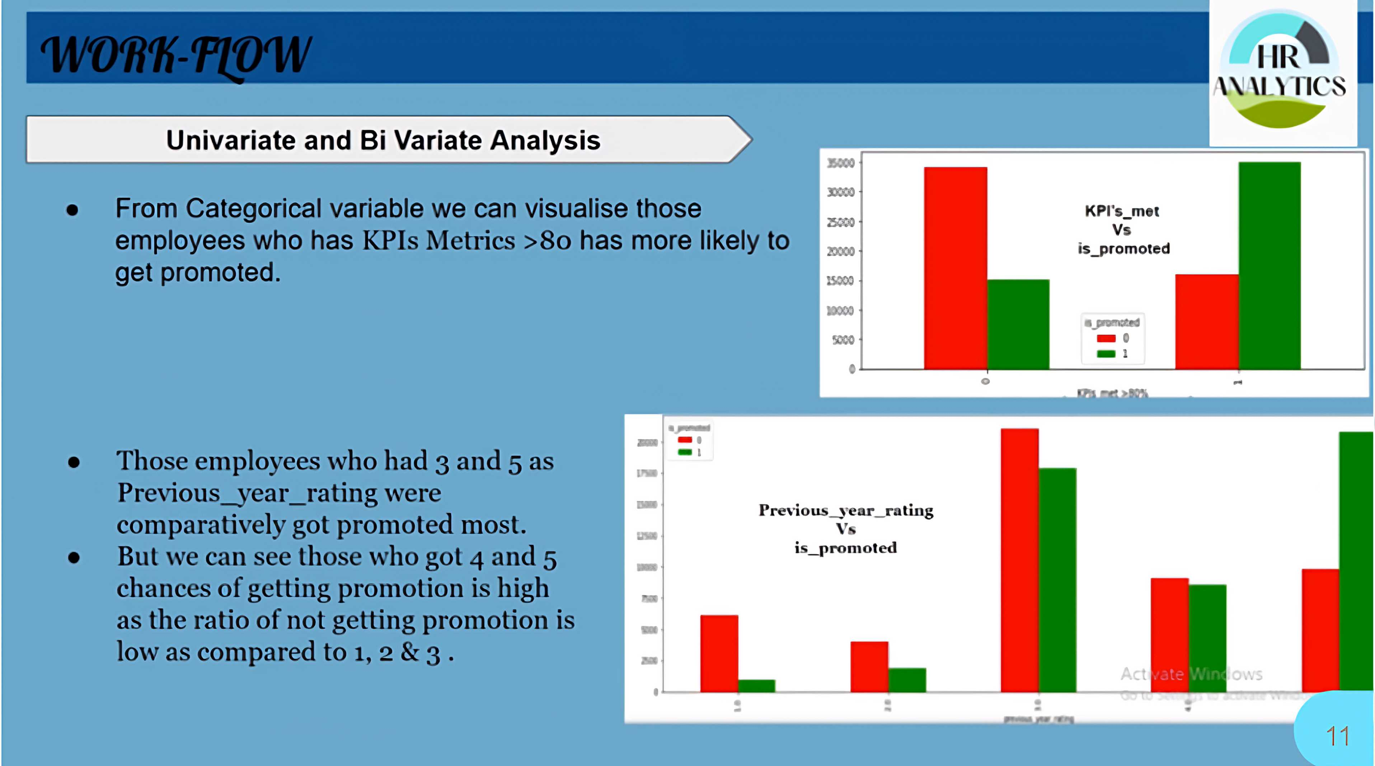
11

Slide 12
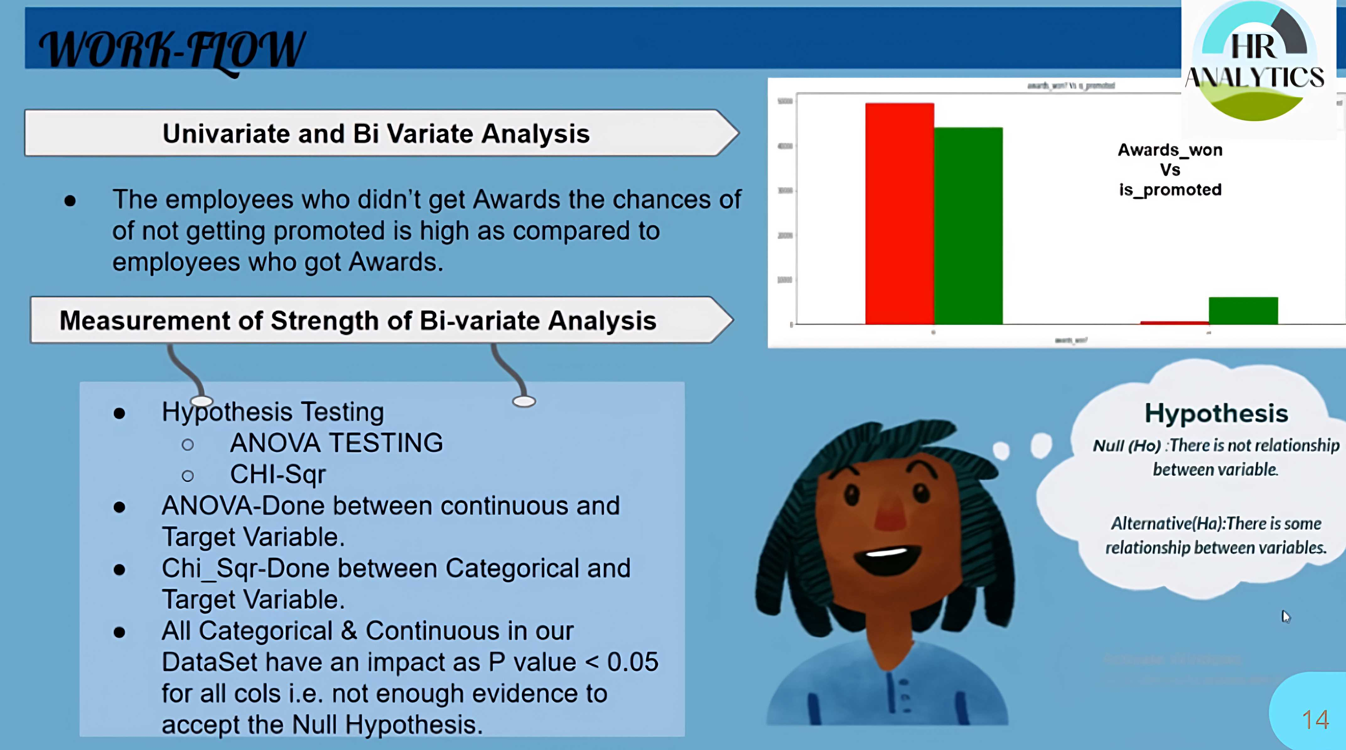
12

Slide 13
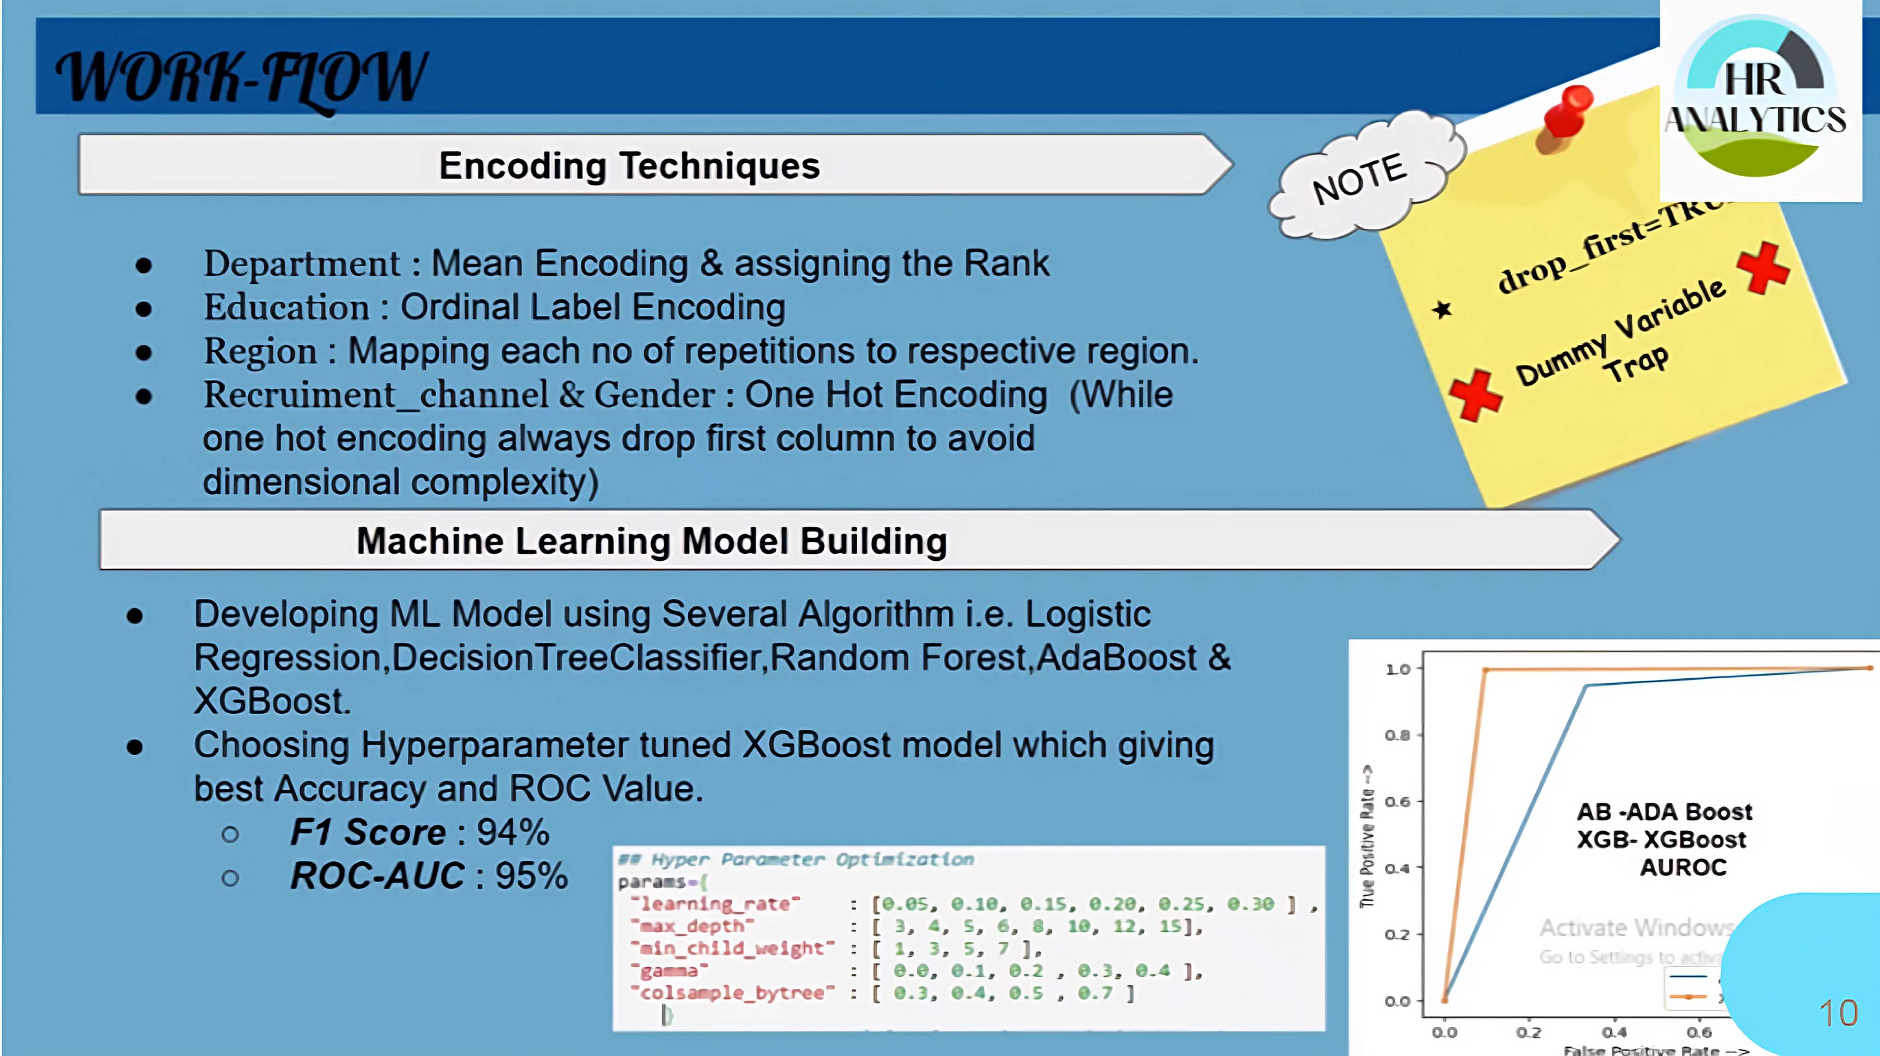
13

Slide 14
THANK YOU

